Slide 1

Software Testing
Sana Rizwan
Assistant Professor
Department of Computer Science, CUI Lahore

Slide 2
Chapter 4 – Static Testing

Slide 3
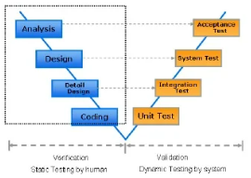

What is static testing?
Static Testing is a software testing technique which is used to check defects in software application without executing the code.
Static testing is done to avoid errors at an early stage of development as it is easier to identify the errors and solve the errors.
It also helps finding errors that may not be found by Dynamic Testing. Its counterpart is Dynamic Testing which checks an application when the code is run.

Slide 4
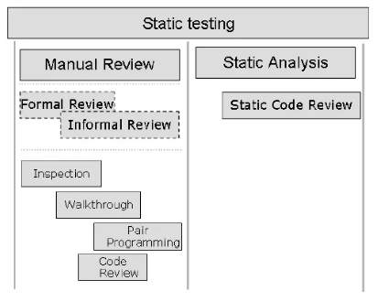
Types of Static Testing
Manual examinations: Manual examinations include analysis of code done manually, also known as REVIEWS.
Automated analysis using tools: Automated analysis are basically static analysis which is done using tools.

Slide 5
What is inspection?
Software inspection involves people examining the source representation with the aim of discovering anomalies and defects.
An inspection does not require execution. A system so may be used before the implementation process. There may be applied to any representation of the system requirements, design, test data, configuration data, etc. They have been shown to be an effective technique for discovering program error.
The software inception is conducted only when the author, i.e. developer, has made sure that the code is ready for inspection. He decides it by performing some preliminary desk checking and walkthrough on the code. After passing through these review methods, the code is then sent for group inception.

Slide 6
What is walkthrough?
It is not a formal process/review
It is led by the authors
Author guide the participants through the document according to his or her thought process to achieve a common understanding and to gather feedback.
Useful for the people if they are not from the software discipline, who are not used to or cannot easily understand software development process.
Is especially useful for higher level documents like requirement specification, etc.

Slide 7
What is pair programming?
Pair programming is a development technique in which two programmers work together at single workstation. Person who writes code is called a driver and a person who observes and navigates each line of the code is called navigator. They may switch their role frequently. Sometimes pair programming is also known as pairing.
Pairing Variations :
There are three pairing variations –
Newbie-newbie pairing can sometimes give a great result. Because it is better than one solo newbie. But generally, this pair is rarely practiced.
Expert–newbie pairing gives significant results. In this pairing, a newbie can learn many things from expert, and expert gets a chance to share his knowledge with newbie.
Expert–expert pairing is a good choice for higher productivity as both of them would be expert, so they can work very efficiently.

Slide 8
What is code review?
Code Review is the method of assuring the quality and relevance of Software.
Under this concept of Software testing, source code is being tested manually by the users.
Code review is an essential part of quality assurance. But if your team can't get together to review code, you'll be stuck with the same mistakes over and over again.
With the Code Review process, you can see what's wrong with your application before you release it to improve your development process.

Slide 9
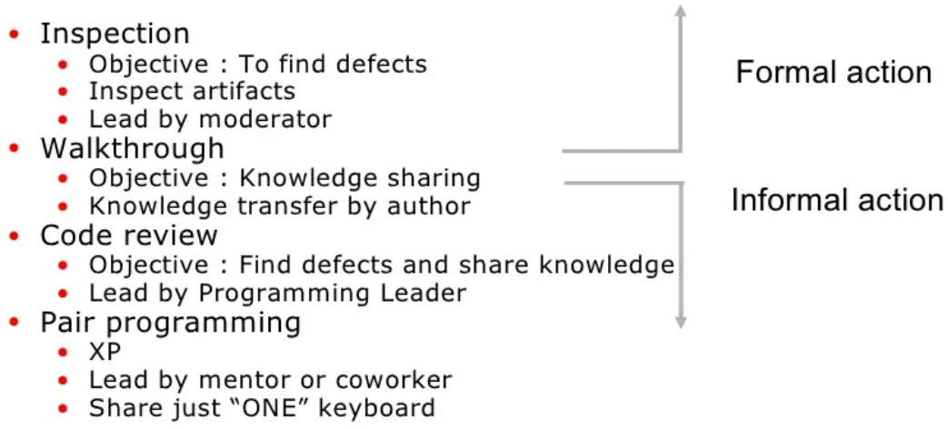
What is review testing?
A review in a Static Testing is a process or meeting conducted to find the potential defects in the design of any program. Another significance of review is that all the team members get to know about the progress of the project and sometimes the diversity of thoughts may result in excellent suggestions. Documents are directly examined by people and discrepancies are sorted out.
Reviews can further be classified into four parts:
Informal reviews
Walkthroughs
Technical review
Inspections

Slide 10
Participants of Review Type Process
During the Review process four types of participants that take part in testing are:
Moderator: Performs entry check, follow up on rework, coaching team member, schedule the meeting.
Author: Takes responsibility for fixing the defect found and improves the quality of the document
Scribe: It does the logging of the defect during a review and attends the review meeting
Reviewer: Check material for defects and inspects
Manager: Decide on the execution of reviews and ensures the review process objectives are met.

Slide 11
Types of defects during static testing
Types of defects which can be easier to find during static testing are:
Deviations from standards
Non-maintainable code
Design defects
Missing requirements
Inconsistent interface specifications
Usually, the defect discovered during static testing are due to security vulnerabilities, undeclared variables, boundary violations, syntax violations, inconsistent interface, etc.

Slide 12
Reasons to perform static testing
Static testing is performed due to the following reasons
Early defect detection and correction
Reduced development timescales
Reduced testing cost and time
For improvement of development productivity
To get fewer defect at a later stage of testing

Slide 13
Tested items in static testing
In Static Testing, following things are tested
Unit Test Cases
Business Requirements Document (BRD)
Use Cases
System/Functional Requirements
Prototype
Prototype Specification Document
DB Fields Dictionary Spreadsheet
Test Data
Traceability Matrix Document
User Manual/Training Guides/Documentation
Test Plan Strategy Document/Test Cases
Automation/Performance Test Scripts

Slide 14
Ways to perform static testing
To perform Static Testing, it is done in the following ways,
Carry out the inspection process to completely inspect the design of the application
Use a checklist for each document under review to ensure all reviews are covered completely

Slide 15
Activities for static testing
The various activities for performing Static Testing are:
Use Cases Requirements Validation: It validates that all the end-user actions are identified, as well as any input and output associated with them. The more detailed and thorough the use cases are, the more accurate and comprehensive the test cases can be.
Functional Requirements Validation: It ensures that the Functional Requirements identify all necessary elements. It also looks at the database functionality, interface listings, and hardware, software, and network requirements.
Architecture Review: All business level process like server locations, network diagrams, protocol definitions, load balancing, database accessibility, test equipment, etc.
Prototype/Screen Mockup Validation: This stage includes validation of requirements and use cases.
Field Dictionary Validation: Every field in the UI is defined well enough to create field level validation test cases. Fields are check for min/max length, list values, error messages, etc.

Slide 16
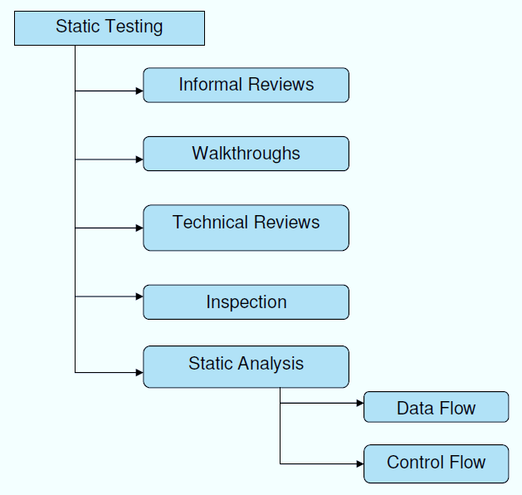
Static Testing Techniques

Slide 17
Successful static testing process
Some useful ways to perform a static testing process in Software Engineering.
Focus only on things that really count
Explicitly plan and track review activities. A software walkthrough and inspection are generally composite into peer’s reviews
Train participants with Examples
Resolve people issues
Keep process formal as the project culture
Continuous Improvement – Process and Tools
By removing the major delays in test execution, testing cost and time can be reduced

Slide 18
Static Analysis
The objective of static analysis is, as with reviews, to reveal defects or defect-prone parts in a document. However, in static analysis, tools do the analysis.
For example, even spell checkers can be regarded as a form of ➞static analyzers because they find mistakes in documents and therefore contribute to quality improvement.
The term static analysis points to the fact that this form of checking does not involve an execution of the checked objects (of a program). An additional objective is to derive measurements, or metrics, in order to measure and prove the quality of the object.
A certain formal structure in order to be checked by a tool. Static analysis makes sense only with the support of tools.
Formal documents can note, for example, the technical requirements, the software architecture, or the software design. An example is the modeling of class diagrams in UML. Generated outputs in HTML or XML can also be subjected to tool-supported static analysis.
Formal models developed during the design phases can also be analyzed and inconsistencies can be detected.
Unfortunately, in practice, the program code is often the one and only formal document in software development that can be subjected to static analysis.

Slide 19
Static Analysis and review
Static analysis and reviews are closely related. If a static analysis is performed before the review, a number of defects and deviations can be found and the number of the aspects to be checked in the review clearly decreases. Due to the fact that static analysis is tool supported, there is much less effort involved than in a review.
If documents are formal enough to allow tool-supported static analysis, then it should be performed before the document reviews because faults and deviations can be detected conveniently and cheaply, and the reviews can be shortened.
Generally, static analysis should be used even if no review is planned. Each time a discrepancy is located and removed, the quality of the document increases.

Slide 20

Defects from static testing
Not all defects can be found using static testing. Some defects become apparent only when the program is executed (that means at runtime) and cannot be recognized before. For example, if the value of the denominator in a division is stored in a variable, that variable can be assigned the value zero. This leads to a failure at runtime. In static analysis, this defect cannot easily be found, except for when the variable is assigned the value zero by a constant having zero as its value.
All possible paths through the operations may be analyzed, and the operation can be flagged as potentially dangerous. On the other hand, some inconsistencies and defect-prone areas in a program are difficult to find by dynamic testing. Detecting violation of programming standards or use of forbidden error-prone program constructs is possible only with static analysis (or reviews).
The compiler is an analysis tool. All compilers carry out a static analysis of the program text by checking that the correct syntax of the programming language is used. Most compilers provide additional information, which can be derived by static analysis. In addition to compilers, there are other tools that are so-called analyzers. These are used for performing special analyses or groups of analyses.

Slide 21
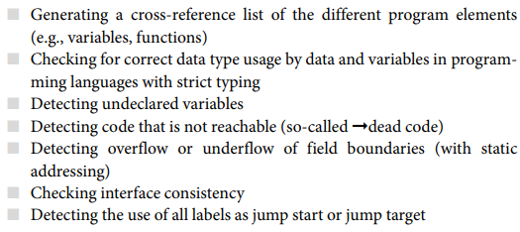
1. The Compiler as a Static Analysis Tool

Slide 22
2. Examination of Compliance to Conventions and Standards
Compliance to conventions and standards can also be checked with tools.
For example, tools can be used to check if a program follows programming regulations and standards. This way of checking takes little time and almost no personnel resources.

Slide 23
3. Execution of Data Flow Analysis
Data flow analysis is another means to reveal defects. Usage of data on paths through the program code is checked. It is not always possible to decide if an issue is a defect or anomalies, or data flow anomalies.
Anomaly
An anomaly is an inconsistency that can lead to failure. An anomaly may be flagged as a risk.
An example of a data flow anomaly is code that reads (uses) variables without previous initialization or code that doesn’t use the value of a variable at all. The analysis checks the usage of every single variable.
The following three types of usage or states of variables are distinguished:
■ Defined (d): The variable is assigned a value.
■ Referenced (r): The value of the variable is read and/or used.
■ Undefined (u): The variable has no defined value.

Slide 24
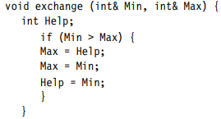
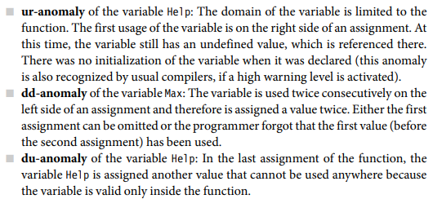








Anomaly example:
We will use the following example (in C++) to explain the different anomalies. The following function is supposed to exchange the integer values of the parameters Max and Min with the help of the variable Help, if the value of the variable Min is greater that the value of the variable Max:

Slide 25
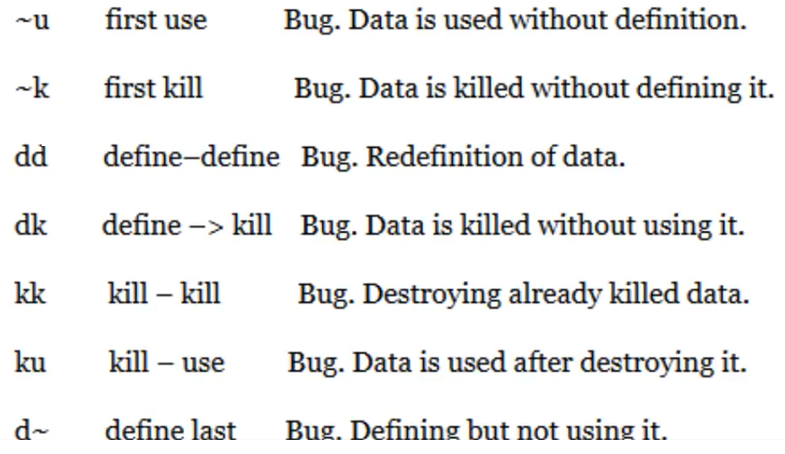
Anomalies which shows bug and should be avoided in the programs

Slide 26
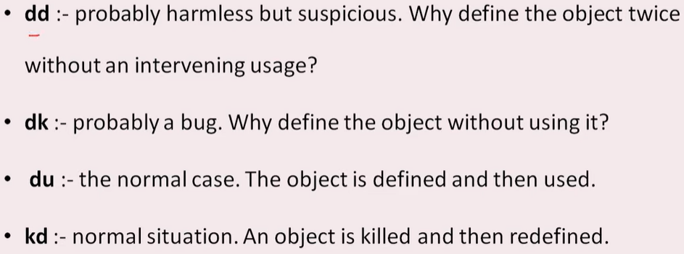
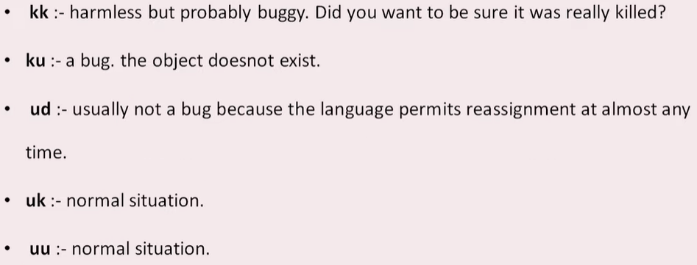
Anomaly Symbol

Slide 27
Logical bugs are identified by Data Flow testing
Int x;
myClass Obj;
If(x<1000)
Print (“X is less than 1000”);
x = 171;
x = 181;
a = x+100;
Cout << “x”;

Slide 28
Why dft?
1. Definition:
→ int x = 101; x is container
→ x = x+100; x is new value
2. Use:
→ Predicate use or P use ---- if(x<1000)
→ Computation use or C-use ---- a=x+100; and print
3. Killing: Stack, heap, delete
→ Automatically (define variable in Stack) go out of the scope.
→ Manually (define variable on heap) delete manual with delete operator.

Slide 29
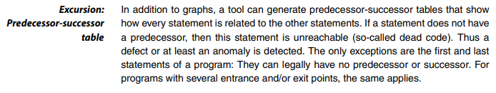

4. Execution of Control Flow Analysis
Program structure is represented as a control flow graph.
Control flow graph in the directed graph, the statements of the program are represented with nodes.
Sequences of statements are also represented with a single node because inside the sequence there can be no change in the course of program execution. If the first statement of the sequence is executed, the others are also executed.
Changes in the course of program execution are made by decisions, such as, for example, in IF statements. If the calculated value of the condition is true, then the program continues in the part that begins THEN. If the condition is false, then the ELSE part is executed. Loops lead to previous statements, resulting in repeated execution of a part of the graph.

Slide 30

5. Determining Metrics
In addition to the previously mentioned analyses, static analysis tools provide measurement values.
Quality characteristics can be measured with measurement values, or metrics.
The definition of metrics for certain characteristics of software is based on the intent to gain a quantitative measure of software. Metric can only provide statements concerning the one aspect that is examined, and the measurement values that are calculated are only interesting in comparison to numbers from other programs or program parts that are examined.
Cyclomatic number take a closer look at a certain metric:
➞cyclomatic number (McCabe number [McCabe 76]). The cyclomatic number measures the structural complexity of program code. The basis of this calculation is the control flow graph.

Slide 31
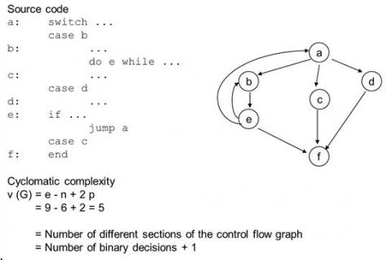
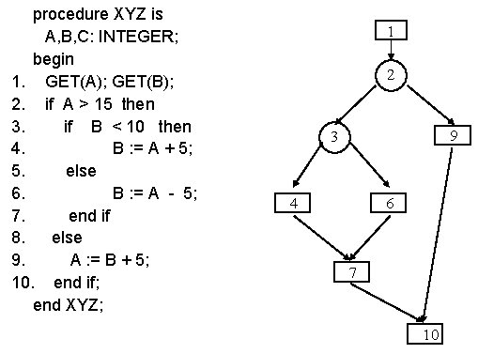
Cyclomatic complexity examples:

Slide 32
Data Flow Testing
Data flow testing is used to analyze the flow of data in the program. It is the process of collecting information about how the variables flow the data in the program. It tries to obtain particular information of each particular point in the process.
Data flow testing is a group of testing strategies to examine the control flow of programs in order to explore the sequence of variables according to the sequence of events. It mainly focuses on the points at which values assigned to the variables and the point at which these values are used by concentrating on both points, data flow can be tested.
Data flow testing uses the control flow graph to detect illogical things that can interrupt the flow of data. Anomalies in the flow of data are detected at the time of associations between values and variables due to:
If the variables are used without initialization.
If the initialized variables are not used at least once.

Slide 33
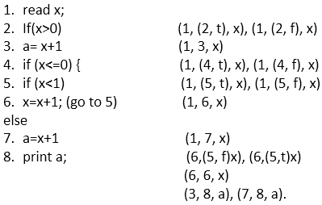

Example
When we set value of x as 1 first it come on step 1 to read and assign the value of x (we took 1 in path) then come on statement 2 (x>0 (we took 2 in path)) which is true and it comes on statement 3 (a= x+1 (we took 3 in path)) at last it comes on statement 8 to print the value of x (output is 2).
For the second path, we take the value of x is 1
2. Set x= -1 Path = 1, 2, 4, 5, 6, 5, 6, 5, 7, 8
In this code, we have a total 8 statements, and we will choose a path which covers all the 8 statements. As it is evident in the code, we cannot cover all the statements in a single path because if statement 2 is true then statements 4, 5, 6, 7 not covered, and if statement 4 is true then statement 2 and 3 are not covered.
So, we are taking two paths to cover all the statements.
1. x= 1 Path - 1, 2, 3, 8

Slide 34
Major types of usage nodes
The two major types of usage node are:
P-use: predicate use – the variable is used when making a decision (e.g. if b > 6).
C-use: computation use – the variable is used in a computation (for example, b = 3 + d – with respect to the variable d).

Slide 35
Associations
These are the all association which contain definition, Predicate use (p-use), Computation use (c-use)
(1, (2, f), x)
(1, (2, t), x)
(1, 3, x)
(1, (4, t), x)
(1, (4, f), x)
(1, (5, t), x)
(1, (5, f), x)
(1, 6, x)
(1, 7, x)
(6,(5, f)x)
(6,(5,t)x)
(6, 6, x)
(3, 8, a)
(7, 8, a).

Slide 36
How to Make Associations
(1, (2, t), x), (1, (2, f), x) - This association is made with statement 1 (read x;) and statement 2 (If(x>0)) where x is defined at line number 1, and it is used at line number 2 so, x is the variable. Statement 2 is logical, and it can be true or false that's why the association is defined in two ways; one is (1, (2, t), x) for true and another is (1, (2, f), x) for false.
(1, 3, x) - This association is made with statement 1 (read x;) and statement 3 (a= x+1) where x is defined in statement 1 and used in statement 3. It is a computation use.
(1, (4, t), x), (1, (4, f), x) - This association is made with statement 1 (read x;) and statement 4 (If(x<=0)) where x is defined at line number 1 and it is used at line number 4 so x is the variable. Statement 4 is logical, and it can be true or false that's why the association is defined in two ways one is (1, (4, t), x) for true and another is (1, (4, f), x) for false.
(1, (5, t), x), (1, (5, f), x) - This association is made with statement 1 (read x;) and statement 5 (if (x<1)) where x is defined at line number 1, and it is used at line number 5, so x is the variable. Statement 5 is logical, and it can be true or false that's why the association is defined in two ways; one is (1, (5, t), x) for true and another is (1, (5, f), x) for false.
(1, 6, x) - This association is made with statement 1 (read x;) and statement 6 (x=x+1). x is defined in statement 1 and used in statement 6. It is a computation use.

Slide 37
How to Make Associations
(1, 7, x) - This association is made with statement 1 (read x) and statement 7 (a=x+1). x is defined in statement 1 and used in statement 7 when statement 5 is false. It is a computation use.
(6, (5, f) x), (6, (5, t) x) - This association is made with statement 6 (x=x+1;) and statement 5 if (x<1) because x is defined in statement 6 and used in statement 5. Statement 5 is logical, and it can be true or false that's why the association is defined in two ways one is (6, (5, f) x) for true and another is (6, (5, t) x) for false. It is a predicted use.
(6, 6, x) - This association is made with statement 6 which is using the value of variable x and then defining the new value of x. x=x+1 x= (-1+1) Statement 6 is using the value of variable x that is ?1 and then defining new value of x [x= (-1+1) = 0] that is 0.
(3, 8, a) - This association is made with statement 3(a= x+1) and statement 8 where variable a is defined in statement 3 and used in statement 8.
(7, 8, a) - This association is made with statement 7(a=x+1) and statement 8 where variable a is defined in statement 7 and used in statement 8.

Slide 38
Definition
Definition of a variable is the occurrence of a variable when the value is bound to the variable. In the above code, the value gets bound in the first statement and then start to flow.
If(x>0) is statement 2 in which value of x is bound with it. Association of statement 2 is (1, (2, f), x), (1, (2, t.)
a= x+1 is statement 3 bounded with the value of x Association of statement 3 is (1, 3, x)

Slide 39
Predicate use (p-use)
Predicate use (p-use)
If the value of a variable is used to decide an execution path is considered as predicate use (p-use). In control flow statements there are two Statement 4 if (x<=0) is predicate use because it can be predicate as true or false. If it is true then if (x<1),6x=x+1; execution path will be executed otherwise, else path will be executed.

Slide 40
Computation use (c-use)
Computation use (c-use)
If the value of a variable is used to compute a value for output or for defining another variable.
Statement 3 a= x+1 (1, 3, x) Statement 7 a=x+1 (1, 7, x) Statement 8 print a (3, 8, a), (7, 8, a).
These are Computation use because the value of x is used to compute and value of a is used for output.

Slide 41
coverages
All c-use coverage
(1, 3, x), (1, 6, x), (1, 7, x), (6, 6, x), (6, 7, x), (3, 8, a), (7, 8, a).
All c-use some p-use coverage
(1, 3, x), (1, 6, x), (1, 7, x), (6, 6, x), (6, 7, x), (3, 8, a), (7, 8, a).
All p-use some c-use coverage
(1, (2, f), x), (1, (2, t), x), (1, (4, t), x), (1, (4, f), x), (1, (5, t), x), (1, (5, f), x), (6, (5, f), x), (6, (5, t), x), (3, 8, a), (7, 8, a).
After collecting these groups, (By examining each point whether the variable is used at least once or not) tester can see all statements and variables are used. The statements and variables which are not used but exist in the code, get eliminated from the code.

Slide 42
The end

